Slide 1

DriverPass System Analysis
Reice Morgan
Notes:
[No speaker notes required for this slide.]

Slide 2

System Requirements
Web-based system, available anywhere
Secure login and user accounts
Online scheduling and payments
Role-based access for students, staff, and admins
Notes:
The DriverPass system will be available online, so students and staff can log in from any device. Each user will have their own account, with secure login features to protect personal information. Students can schedule lessons and make payments online. Different users, students, instructors, IT staff, and administrators will each have the right level of access for their role.

Slide 3
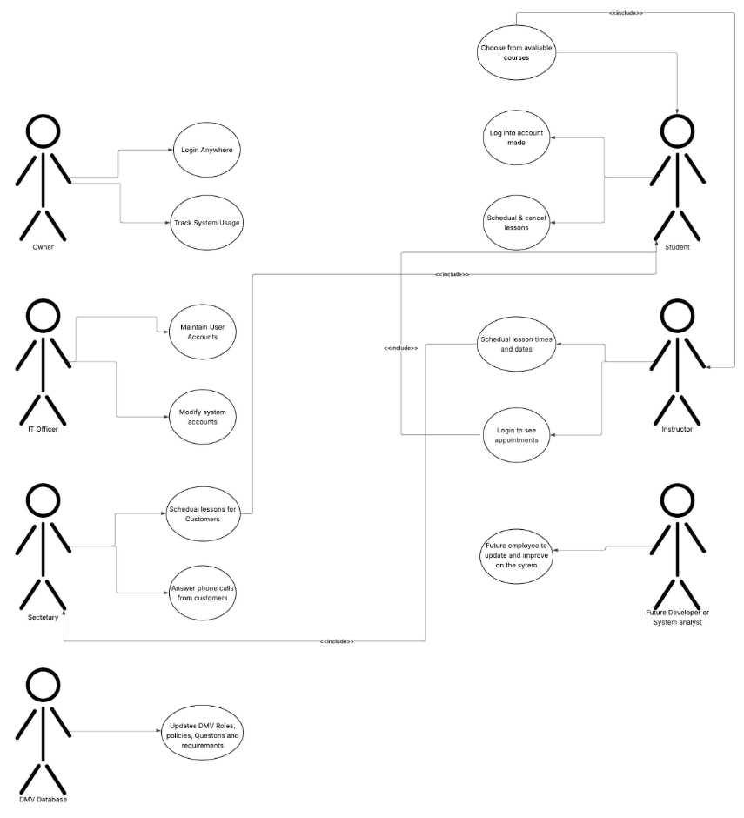
Use Case Diagram
Notes:
This diagram shows the main users of the system and what they can do. Students can log in, schedule and cancel lessons, and choose courses. Instructors can check their appointments and update schedules. The IT officer and secretary help manage accounts and customer requests. The DMV can update policies, and even future developers can improve the system. Each role has only the tools they need to make the system simple and secure.

Slide 4
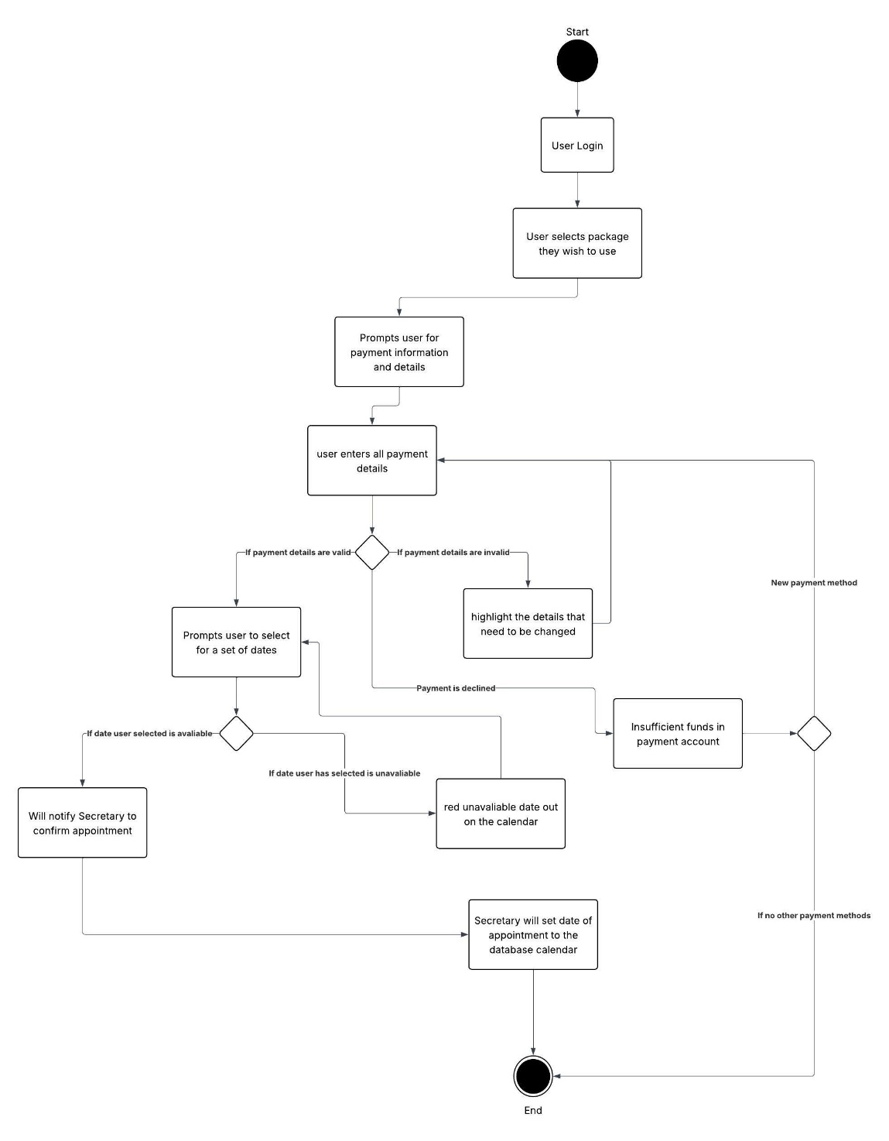
Activity Diagram
Notes:
This diagram shows what happens when a user logs in. If they enter their username and password correctly, they get access to their account. If they try too many times with the wrong information, their account locks. At that point, an administrator is notified and can help the user reset their password. This makes the system more secure while still allowing staff to help when needed.

Slide 5
Security
Password-protected login
Account lock after failed attempts
Encrypted connections
Role-based access
Notes:
Security is built into every part of this system. Users must log in with their own account. If someone tries too many wrong passwords, the account will lock until an administrator resets it. All information is protected with encryption so it cannot be intercepted. And each type of user only has access to what they need, for example, students cannot see administrator tools.

Slide 6
System Limitations
Internet connection required
Initial training needed
Setup and testing required before launch
Notes:
As with any online system, DriverPass will require an internet connection to work. Some training may be needed at the start, so everyone knows how to use the system. Before launch, there will be a setup and testing period to make sure everything works smoothly. These are normal parts of any new system and will help ensure success once it goes live.

